Slide 1
Mod 7 - Securing AWS Resources
SYS-360

Slide 2
AWS Security Resources
We touched on a number already - but will cover:
IAM - Identity and Access Management
Encryption
Data Protection
Regulatory Compliance

Slide 3
Identity and Access Management (IAM)
Important service in AWS - and has dashboard like other services we have used (EC2, S3…)
IAM: a service to control which people and processes get past the wall guarding your resources (authentication) and what they’re allowed to do once they’re in (authorization).
Incorporates users, groups, roles, and federated identities.
We do not have full access to IAM because of Vocareum

Slide 4
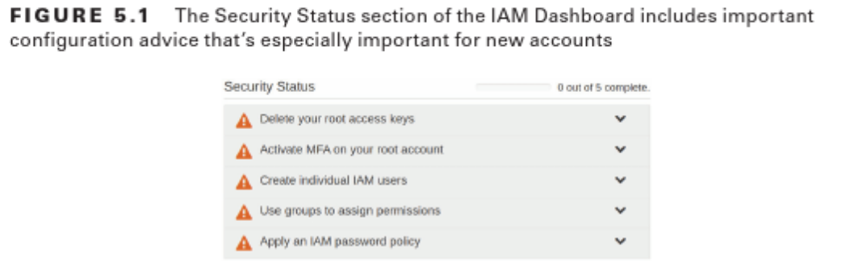
IAM Dashboard
The IAM Dashboard has some good tips on securing access:
They include, protecting the root account, create new users, set a password policy

Slide 5
Protecting Root User
The recommended best practice is to protect the root user by:
creating a complex password
implementing multifactor authentication
and, for most administration activities, use IAM users instead.
MFA options (configure in IAM)
Virtual MFA Device This is an app installed on your smartphone, such as Authy, the Microsoft Authenticator, Google Authenticator, etc.
U2F Security Key This uses a U2F-compliant device, such as Yubikey.
Other Hardware MFA Device This requires the use of a hardware token such as those from Gemalto.
Notes:
Don’t put them on the platform is the best choice, check privacy and sharing settings, remove them from the platform if possible. Impacts – embarrassment, loss of job, trouble with the law, etc.

Slide 6
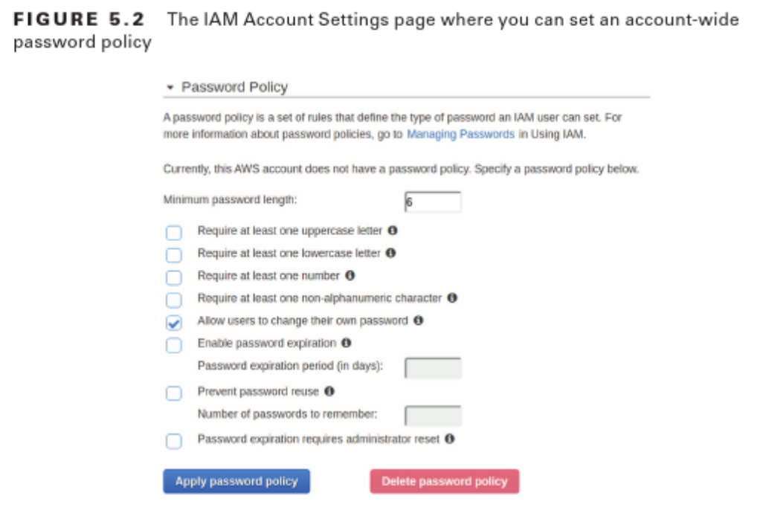
IAM Users: Password Policy
Another Best Practice is to strengthen the default password policy
Default has minimal complexity - 8 character minimum and that is about it.
From IAM Console - Account Settings - Password Policy

Slide 7
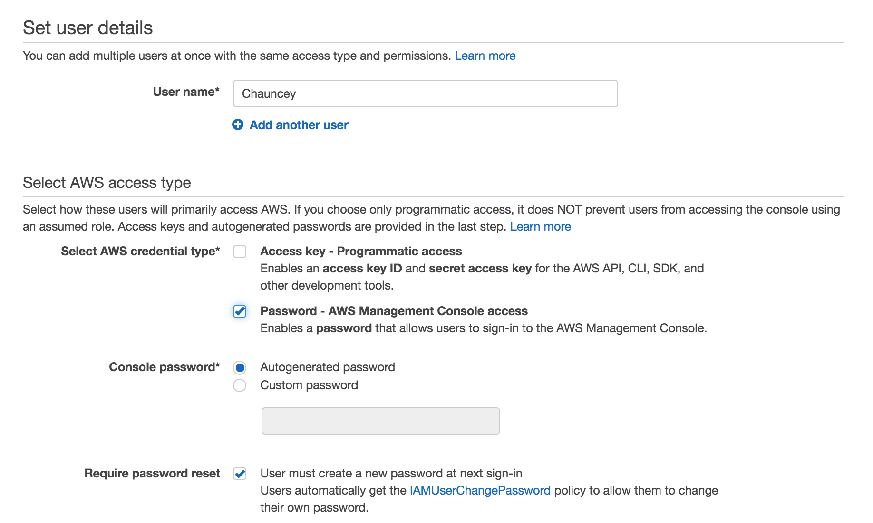
Creating IAM Users
Users can be added through the IAM Console- Users (Add User)
Access Key: For CLI and API
(this is what we use for CLI)
If only this is selected, cannot
Use MFA
Password: Allows for MFA too
A user can have both credentials

Slide 8
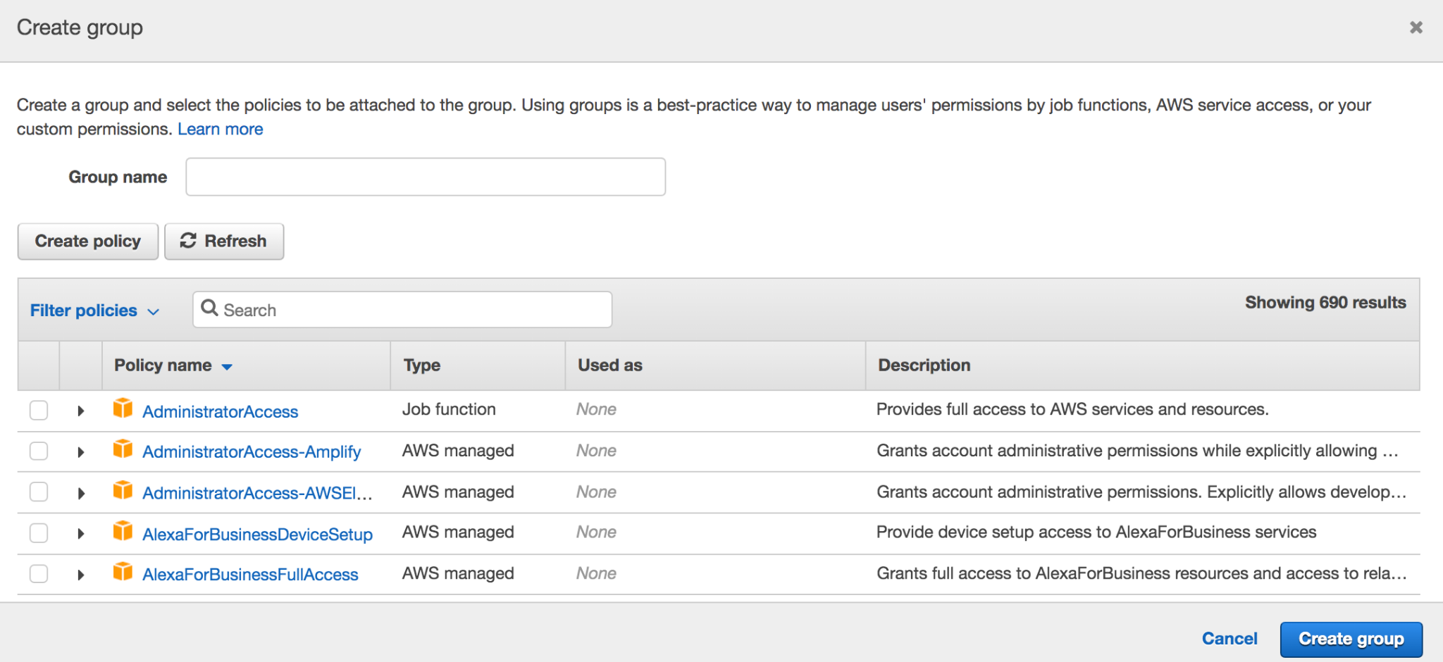
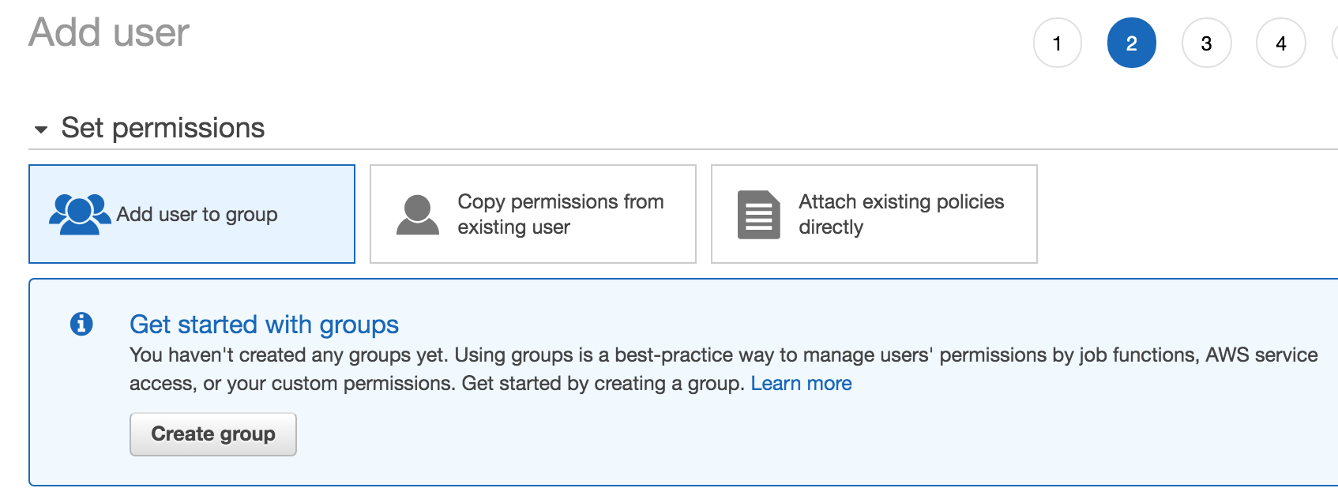
IAM Groups
Groups are used to assign a standard set of permissions to users as they are added to the system.
As you add more users, going through each user and assigning permissions can become a very labor-intensive process, and one that is often fraught with error.
And there are a lot of different permissions (690 in this example!)

Slide 9
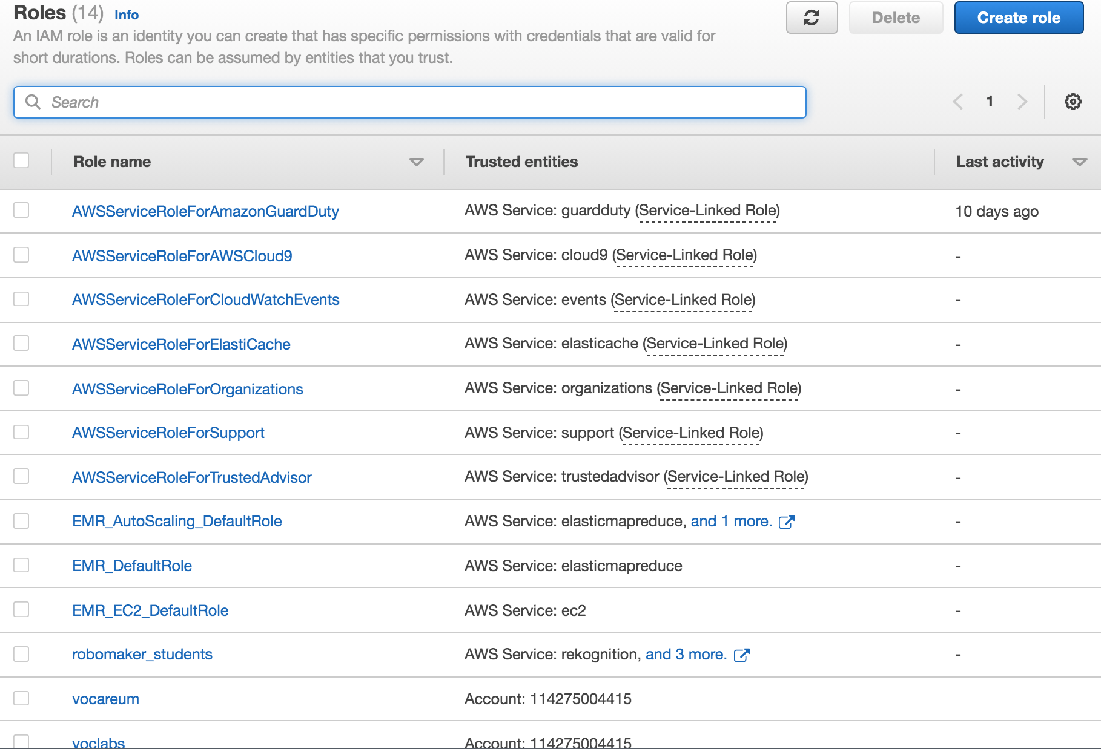
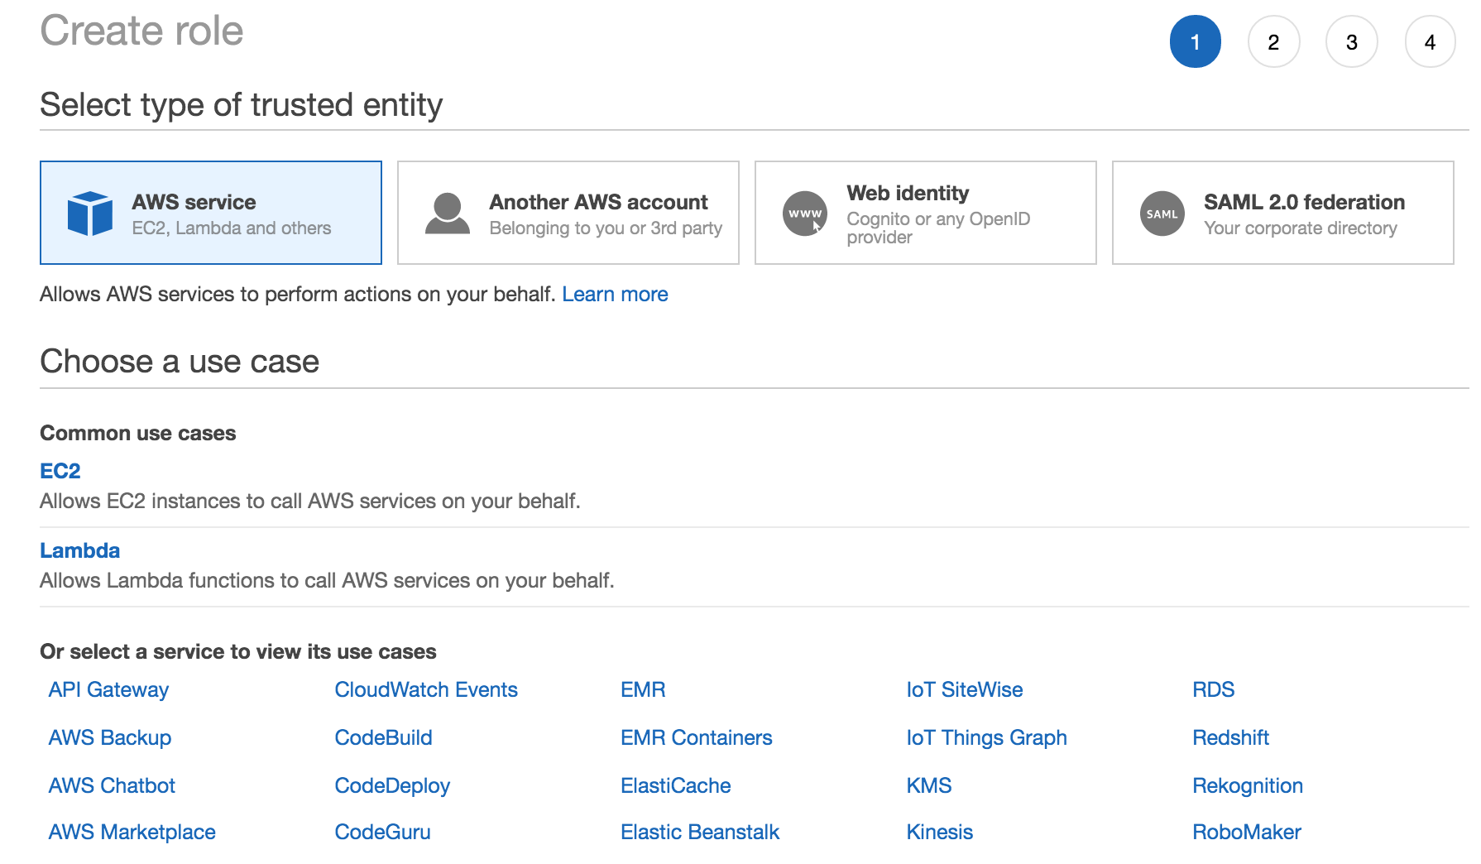
IAM Roles
Like users and groups, IAM roles define the limits for what can be done within your AWS account.
The important difference is that, unlike users and groups, roles are, for the most part, used by applications and services rather than people.

Slide 10
Federated Access
With federated access, technologies such as SAML or Microsoft Active Directory is used to provision users
Alternative to creating users manually through the IAM Console.
The big advantage with using federated access is that users will use accounts and credentials they already have established
This enables an organization to use already existing security and account practices, without having to worry about maintaining them in the IAM Console
Federated Identities are typically mapped to a Role in IAM
For example, our Vocareum logins are mapped to the “vocstartsoft” role
Notes:
Unpack these things, esp. in light of prevent, detect, respond, recover.

Slide 11
SAML 2.0
The most popular method for federated access to AWS is SAML 2.0
SAML is XML based
it is used to exchange information used in the authentication and authorization processes between different parties.
Specifically, it is used for information exchange between identity providers (e.g. Active Directory) and service providers (e.g. AWS)
When an entity (e.g. user) authenticates through an identity provider, it sends a SAML assertion to the service provider containing all the information that the service provider requires to determine the identity and level of access warranted,

Slide 12
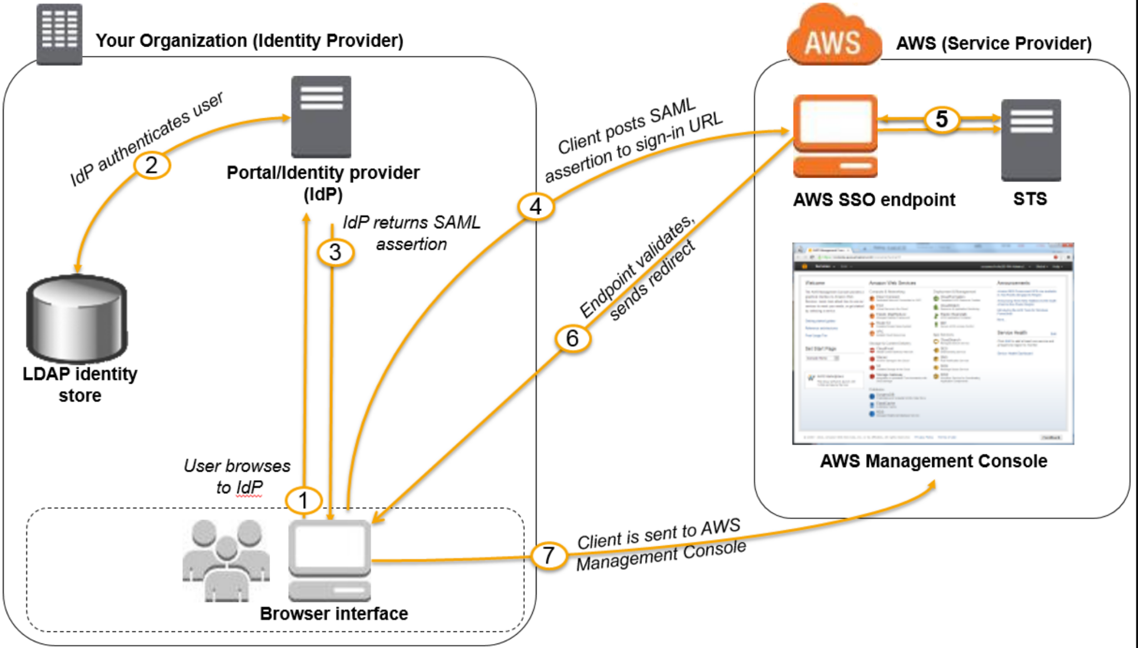
SAML 2.0

Slide 13
IAM Credential Report
Reviewing the AWS accounts for your organization is an important Security Operations Procedure
From the IAM Console, a Credential Report can be downloaded.
It is a CSV file that includes info about each IAM user, including
Creation date/time
Password info
Access key info
Cert info
MFA info
See:
https://docs.aws.amazon.com/IAM/latest/UserGuide/id_credentials_getting-report.html?icmpid=docs_iam_console

Slide 14
AWS Encryption - KMS
AWS Key Management Service (KMS):
Manages Encryption keys— the data files used to control an object’s cryptographic transformation
When you select to encrypt an AWS resource, KMS will apply encryption using a customer master key (CMK) that’s been generated especially for the account.
You can manage your keys through either:
The KMS Dashboard or
The Encryption Keys page within IAM.

Slide 15
AWS Encryption - KMS
What can be encrypted through KMS?
Just about any data managed by an AWS service, including:
Relational Database Service (RDS) and DynamoDB databases.
Elastic Block Store (EBS) volumes that you attach to EC2 instances can also be encrypted when you create them.
Remember, EBS are the drives attached to EC2 Instances
Cannot encrypt existing EBS Volumes
When they’re encrypted, those resources will, for all practical purposes, be unreadable without the decryption key.
AWS will invisibly decrypt your data only when the access request is accompanied by successful authentication.

Slide 16
AWS Encryption - S3
As a refresher from the other week:
Can encrypt the objects of a S3 bucket at any time
Server-side: Either-
S3-managed server-side encryption keys (SSE-S3)
or KMS-managed keys (SSE-KMS).
Encryption-in-Transit requires client-side encryption
You’ll need to encrypt your data before uploading it to S3 using either:
a KMS-managed customer master key
or a clientside master key .
That key will then be used to manage the encryption and decryption throughout the data’s life cycle on the S3 platform.

Slide 17
AWS Artifact - Regulatory Compliance
If your application utilizes or stores any type of sensitive information, there will be specific regulatory requirements that you will need to ensure compliance with.
data can range from credit card and financial information to health records, academic records, or government systems and data
AWS Artifact Service: Assist with meeting regulatory requirements
can be accessed directly from the AWS Management Console
This is included as a service with all AWS accounts and does not require additional costs or services.

Slide 18
AWS Artifact - Regulatory Compliance
As part of the Artifact service, AWS undergoes certification reviews and audits by various governing bodies.
This includes prominent certifications such as:
PCI-DSS for financial/credit card transactions
FedRAMP for U.S. federal government systems.
AWS also makes the pertinent Service Organization Controls (SOC) audit reports available to customers.

